Slide 1
Innocent Botnet
Zachary Job

Slide 2
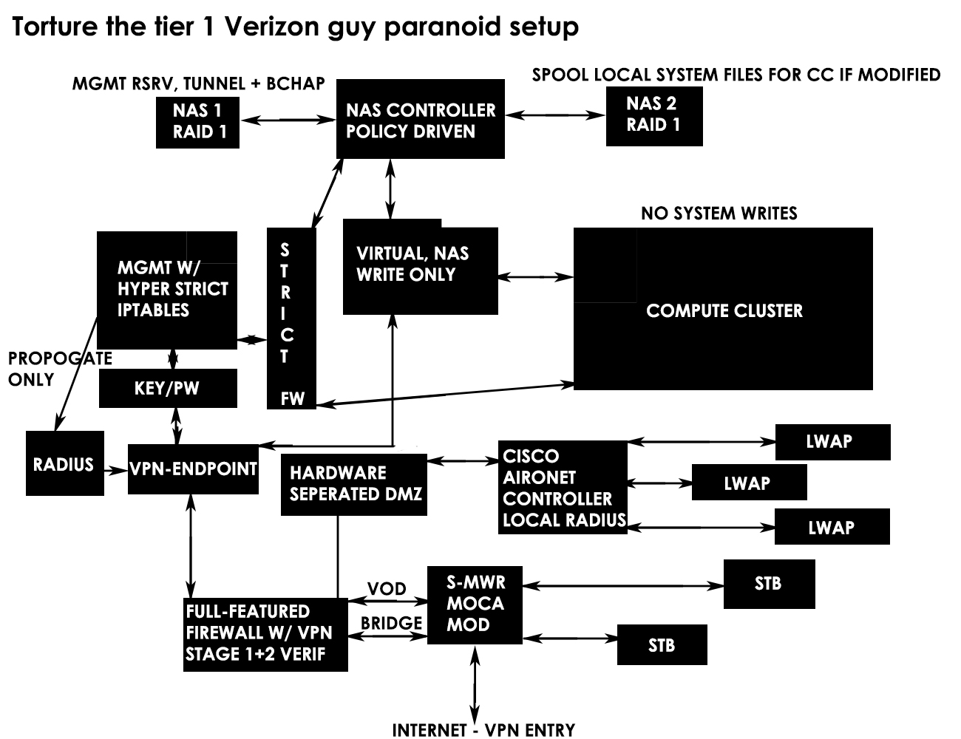

Slide 3
Distributed Processing

Slide 4
How could it relate?
<iframe id="hist_frame" class="invfr" aria-hidden="true" title="empty" tabindex="-1" src="?ui=2&view=bsp&ver=ohhl4rw8mbn4" name="hyiguzmuwqonp"></iframe>
<script type="text/javascript"></script>
<script type="text/javascript"></script>
<div class="ata-asE" style="display: none;"></div>
<div style="position: absolute; top: -1000px; height: 1px; overflow: hidden;" aria-live="assertive" aria-atomic="true"></div>
<div style="position: absolute; top: -1000px; height: 1px; overflow: hidden;" aria-live="polite" aria-atomic="true"></div>
<div></div>

Slide 5
How does the filter work
MATH-ishly-notreally
A trigger array
Two memory maps
A memory map index offset array
A Trim array

Slide 6
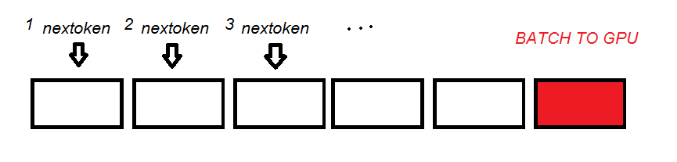
How does this reach the GPU?
Two buffers work in a simple manner, a manager fills a buffer when full
the GPU may begin if the previous kernel call has finished. Note these
updates are overlapped so double buffering occurs

Slide 7
The GPU!
Why does it even relate?

Slide 8
Contention
Threads typically must obtain a lock in order to increment a value safely.
What problems does this pose for a CPU based version?

Slide 9
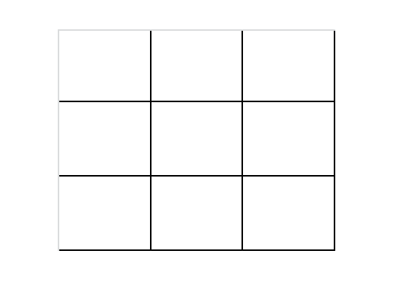
A parallel approach

Slide 10
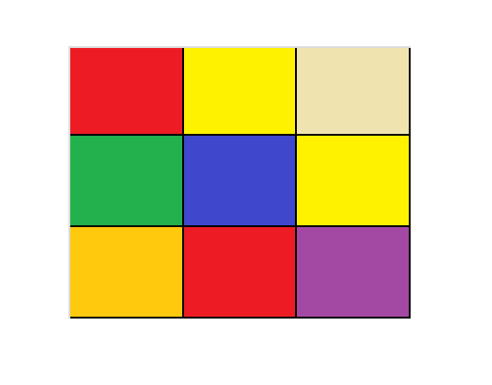

Slide 11
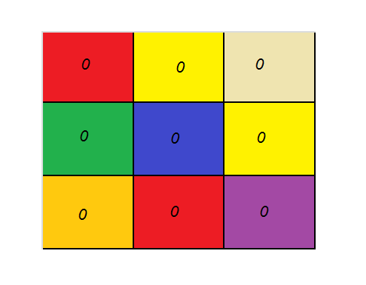

Slide 12
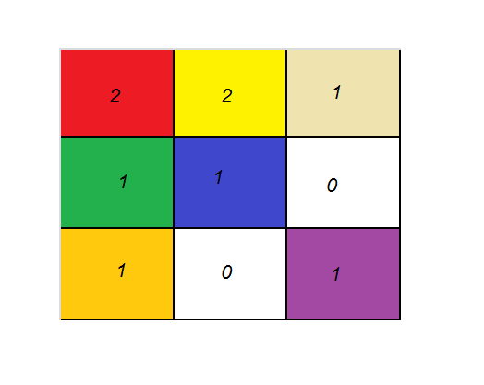

Slide 13
In summary
The key with the least index keeps its updated count

Slide 14
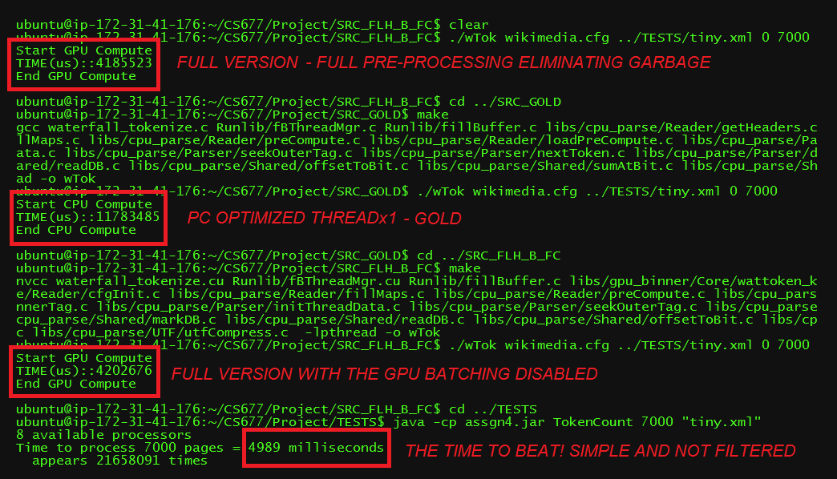

Slide 15
Gold and actual

Slide 16
On the algorithm
K.I.S.S.
A piggy back system
Unrestricted
Adaptable to any language
Modifiable for scalability
Cross platform

Slide 17
On the algorithm
A proof of concept
System
Programmer utilizes the framework freely
Manager
Pushes tasks to server
Server
Manages clients and reports as programmed
Initializes handlers for expected reporting clients
Initializes pushed server code, pushes client code
Client
Handles computational tasks as pushed by server
Allows for specified communications and sandboxing with other clients

Slide 18
Upgrades
Actual manager
Manifests
Scaling
Multiplatform
Multilingual
Error, loss rectification without programming intervention

Slide 19
The problem!
1, 1, 8, 2, 3, 4,
5, 6, 7, 1, 8, 8

Slide 20
The approach
C1: Hey C2! My most frequent is 1!
C2: Whatever, mine’s 8…

Slide 21
The approach
0, 0, 0, 2, 3, 4,
5, 6, 7, 0, 0, 0

Slide 22
The approach
C1: Hey S1! I finished with this!
S1: Cool bro, you can die now.
C2: Done.
S1: Kthks bye.

Slide 23
The solution
0, 0, 0, 2, 3, 4, 5, 6, 7, 0, 0, 0

Slide 24
Questions?
Demo?
More specific?

